Slide 1
DATABRICKS SQL

Slide 2
Databricks SQL
Databricks SQL is a powerful and performant query engine designed for running SQL queries on your data lake. It allows data analysts and data scientists to directly query data stored in various formats (like Delta Lake, Parquet, and CSV) using standard SQL.
This eliminates the need for complex ETL pipelines for many common analytical tasks.

Slide 3
Databricks SQL is a robust analytics tool within the Databricks Lakehouse platform that allows data professionals to run SQL queries, analyze data, and create interactive dashboards.
Designed with a serverless architecture, Databricks SQL combines the flexibility of data lakes with the governance and performance capabilities of data warehouses.
The key components of Databricks SQL include SQL Warehouses, SQL Editors, and SQL Dashboards.

Slide 4
Core Components of Databricks SQL
SQL Warehouses
SQL Editor
Dashboards
Alerts
Query history and profiling

Slide 5
SQL Warehouses
SQL Warehouses serve as the computational resources for executing SQL queries in Databricks SQL. They are designed to handle varying workloads and provide performance optimizations based on the type of warehouse selected. There are three main types of SQL Warehouses:
Classic: This type supports basic functionalities and is suitable for entry-level performance. It utilizes the existing compute layer in your cloud account but lacks advanced features like Intelligent Workload Management (IWM) and Predictive IO.
Pro: Pro SQL Warehouses offer enhanced performance with support for Photon, a vectorized query engine that speeds up SQL operations and improves security options.
Serverless Eliminates infrastructure management by automatically provisioning resources, scaling elastically, and ensuring low-latency query execution. They are ideal for environments with fluctuating workloads and offer cost-effective performance.

Slide 6
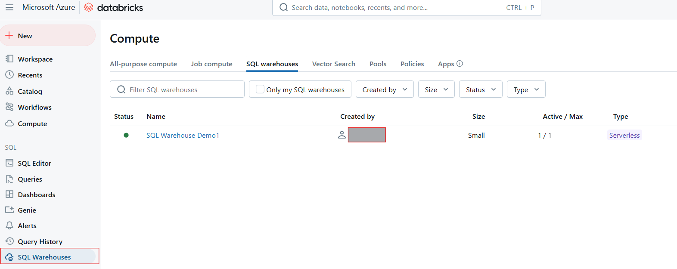

Slide 7
SQL Editor
The SQL Editor is a user-friendly interface that enables users to write, execute, and manage SQL queries. Key features of the SQL Editor include:
Intuitive Querying: Supports syntax highlighting, autocomplete, and error detection for efficient query writing.
Data Preview: Users can preview data directly within the editor, making it easier to understand datasets before executing complex queries.
Query Result Caching: This feature enhances performance by caching previous query results, allowing for faster response times on repeated queries.
Parameterized Queries: Users can create dynamic queries by incorporating parameters, which simplifies the process of running similar queries with different values.

Slide 8
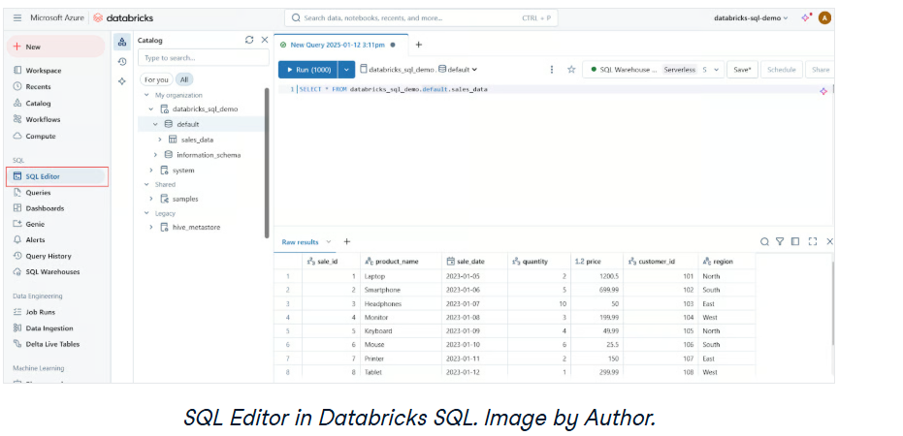

Slide 9
Dashboards
Dashboards enable data visualization by transforming query results into interactive charts, graphs, and widgets. Dashboards are ideal for monitoring key metrics and communicating insights effectively across an organization. The key capabilities of dashboards include the following:
Real-Time Analytics: Automatically refresh dashboards based on live query results.
Collaboration: Share dashboards across teams to promote data-driven decisions.
Customization: Choose from a variety of visualization types and layout options to suit specific needs.

Slide 10
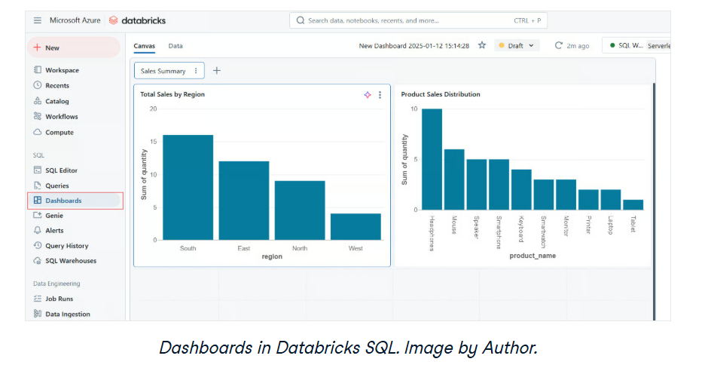

Slide 11
Alerts
Alerts in Databricks SQL provide a way to monitor data changes and trigger notifications when specified conditions are met. Alerts are essential for maintaining data quality and ensuring timely responses to important changes. The alert functionality works in the following way.
Trigger Notifications: Receive alerts via email, Slack, or other integrations when conditions are satisfied.
Proactive Monitoring: Stay informed about critical events, such as data anomalies or system issues, in real-time.

Slide 12
Query history and profiling
Query History: This feature allows users to review previously executed queries, providing insights into their performance over time. It helps identify trends or recurring issues.
Query Profiling: Query profiling tools analyze the efficiency of executed queries, highlighting bottlenecks and suggesting optimizations. This capability is important for improving overall query performance and resource utilization.

Slide 13
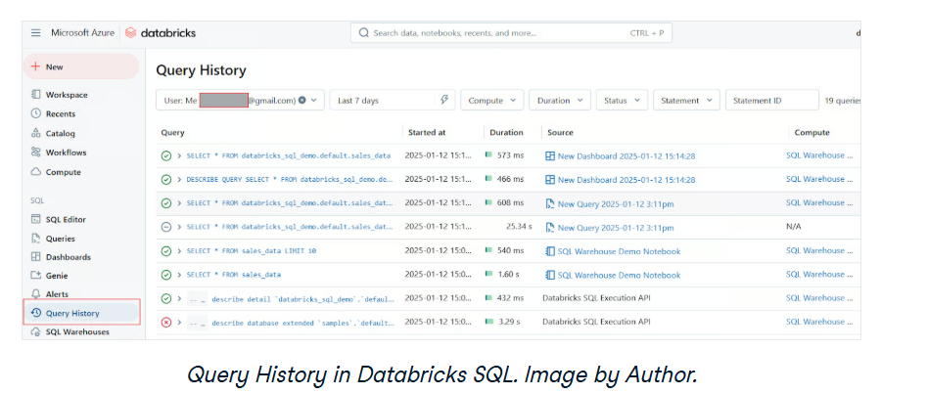

Slide 14
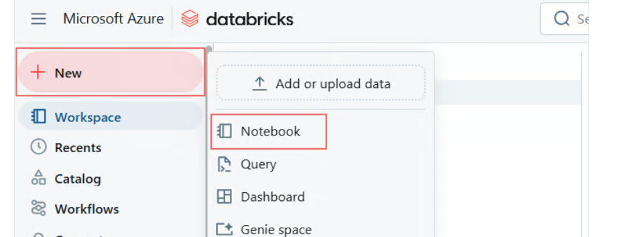
Using a Notebook with a Databricks SQL Warehouse
To execute SQL queries in a notebook using your newly created SQL warehouse, follow these steps:
Step 1: Open or Create a Notebook

Slide 15
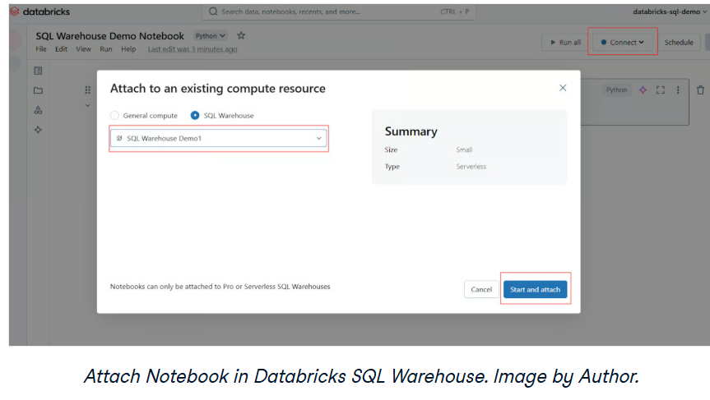
Step 2: Attach the SQL Warehouse
In the Notebook toolbar, locate the compute selector or connect (usually displayed at the top). Click on it to open a dropdown menu showing available compute resources. Select your SQL warehouse from the list

Slide 16
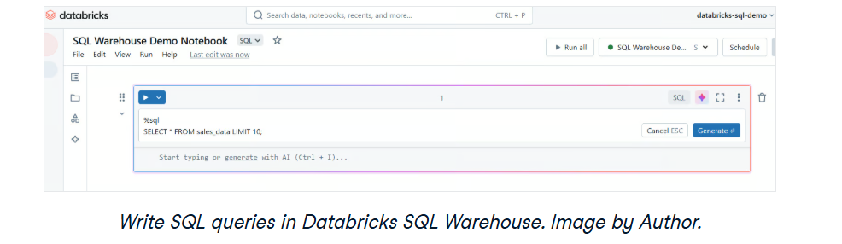
Step 3: Write SQL queries
Once attached, you can create cells in your notebook for SQL queries. Use the %sql magic command to execute SQL queries in the notebook.

